Slide 1

ECEN 3593-001 Computer Organization
Lecture #10
8 February 2021

Slide 2


Agenda
Class Announcements
Class Project
Assembly <-> Machine Language
Finish Chapter 2

Slide 3
Class Announcements
Reading for the week
“Computer Organization and Design, The Hardware / Software Interface, RISC-V edition,” by David Patterson and John Hennessy
ISBN 978-0-12-812275-4
Chapter 4, “The Processor”
pages 236-314 (sections 4.1 thru 4.8)

Slide 4
Class Announcements
Phase 3 target date – Sunday, February 14 at 10:00 PM
Phase 2 is at 10%/day deduction – do not get behind!
Homework #1A due Thursday, February 11 at 10:00 PM
Homework #2 will be posted by tomorrow
Due Thursday, February 18 at 10:00 PM

Slide 5
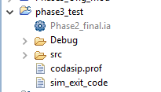
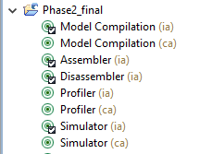
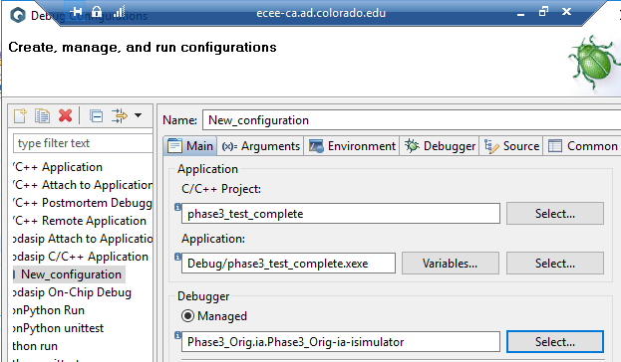
Phase 3 – SDK vs. Debugger
This is the Software Developer Kit (SDK) used to build software
Create it by building the Assembler from a good design
This is the Debugger (Simulator) used to run simulations
Create it by building the Simulator from the design under test

Slide 6
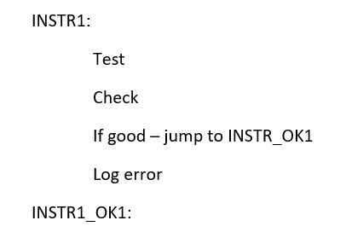
Phase 3 – Getting Started (Check All Cases)
Test the function
Check the output
Log Error if necessary

Slide 7
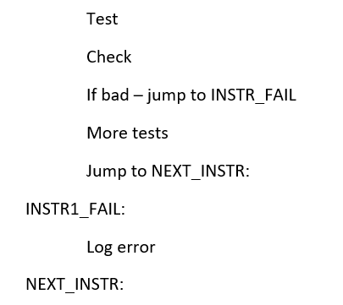
Phase 3 – Getting Started (Exit on Error)
Test the function
Check the output
Log Error if necessary

Slide 8
Phase 3
The penalty for not finding one of your errors is 10% each, so it’s better to delay and create a complete test.
There are also penalties for errors detected in a known good Phase 2 design
There are bonus points for detecting the errors which are NOT in your hardware, so you should test all 14 possible failing instructions. This is much more like a real Verification process.
Ask questions in Slack

Slide 9
Assembly -> Machine Code
What is the RISC-V machine code for the following assembly instruction?
jalr x6, -345(x1)
0b 1110 1010 0111 0000 1000 0011 0110 0111
What do we find first?
Opcode (and fn3)
What do we find next?
rd field
What do we find next?
rs1 field
Calculate the immediate

Slide 10
Calculate the Immediate -345
345 decimal = 1 * 2^8 = 256, remainder 345 – 256 = 89
89 decimal = 1 * 2^6 = 64, remainder 89 – 64 = 25
25 decimal = 1 * 2^4 = 16, remainder 25 – 16 = 9
9 decimal = 0b1001
345 decimal = 0b0001 0101 1001
-345 = 2’s complement
Invert = 0b1110 1010 0110
Add1 = 0b1110 1010 0111

Slide 11
Assembly -> Machine Code
What is the RISC-V machine code for the following assembly instruction?
jalr x6, -345(x1)
0b 1110 1010 0111 0000 1000 0011 0110 0111
0xEA708367
Calculate the immediate

Slide 12
Assembly -> Machine Code
What is the RISC-V machine code for the following assembly instruction?
sb x5, 19(x15)
0b 0000 0000 0101 0111 1010 1001 1010 0011
What do we find first?
Opcode (and fn3)
What do we find next?
rs1 field
What do we find next?
rs2 field
Calculate the immediate

Slide 13
Calculate the Immediate 19
19 decimal = 1 * 2^4 = 16, remainder 19 – 16 = 3
3 decimal = 0b0011
19 decimal = 0b0000 0001 0011

Slide 14
Assembly -> Machine Code
What is the RISC-V machine code for the following assembly instruction?
sb x5, 19(x15)
0b 0000 0000 0101 0111 1000 1001 1010 0011
0x005789A3
Calculate the immediate

Slide 15
Assembly -> Machine Code
What is the RISC-V machine code for the following assembly instruction?
bgeu x19, x26, -72
0b 1111 1011 1010 1001 1111 1100 1110 0011
What do we find first?
Opcode (and fn3)
What do we find next?
rs1 field
What do we find next?
rs2 field
Calculate the immediate

Slide 16
Calculate the Immediate -72
72 decimal = 1 * 2^6 = 64, remainder 72 – 64 = 8
8 decimal = 0b1000
72 decimal = 0b0000 0100 1000
-72 – 2’s complement
Invert = 0b1111 1011 0111
Add 1 = 0b1111 1011 1000
BUT – we divide by 2 (shift right 1)
Offset = 0b1111 1101 1100 (0)

Slide 17
Assembly -> Machine Code
What is the RISC-V machine code for the following assembly instruction?
bgeu x19, x26, -72
0b 1111 1011 1010 1001 1111 1100 1110 0011
0xFBA9FCE3
Calculate the immediate

Slide 18
Machine Code -> Assembly
What is the assembly instruction for the following RISC-V machine code:
0x5CE02E23
0b 0101 1100 1110 0000 0010 1110 0010 0011
sw x14, 1500(x0)
What do we do first?
Convert to binary
What do we find first?
Opcode and fn3
What do we find next?
rs1 and rs2 fields
Calculate the immediate

Slide 19
Calculate the Immediate 0b 0101 1101 1100
0b 0101 1101 1110
1 * 2^10 = 1024
1 * 2^8 = 256
1 * 2^7 = 128
1 * 2*6 = 64
1 * 2*4 = 16
1110 = 12
1024 + 256 + 128 + 64 + 16 + 12 = 1500

Slide 20
Machine Code -> Assembly
What is the assembly instruction for the following RISC-V machine code:
0x5CE02F23
0b 0101 1100 1110 0000 0010 1111 0010 0011
sw x14, 1500(x0)
Calculate the immediate

Slide 21
Machine Code -> Assembly
What is the assembly instruction for the following RISC-V machine code:
0x9D8FD06F
0b 1001 1101 1000 1111 1101 0000 0110 1111
jal x0, 24
What do we do first?
Convert to binary
What do we find first?
Opcode
What do we find next?
rd field
Calculate the immediate

Slide 22
Calculate the Immediate
0b 1001 1101 1000 1111 1101
Rearrange to JAL format – 0b 1 1111 1101 0001 1101 100(0)
31 -> 20
19:12 -> 19:12
20 -> 11
30:21 -> 10:1
Bit 0 = 0
Negative, so 2’s complement – Invert = 0b 0 0000 0010 1110 0010 0111
Add 1 = 0b 0 0000 0010 1110 0010 1000

Slide 23
Calculate the Immediate
0b 0 0000 0010 1110 0010 1000
Compute decimal
2 * 16^3 = 2 * 4096 = 8192
14 * 16^2 = 14 * 256 = 3584
2 * 16^1 = 2 * 16 = 32
1000 = 8
8192 + 3584 + 32 + 8 = 11816
Branch offset = -11816

Slide 24
Machine Code -> Assembly
What is the assembly instruction for the following RISC-V machine code:
0x9D8FD06F
0b 1001 1101 1000 1111 1101 0000 0110 1111
jal x0, -11816
Calculate the immediate

Slide 25
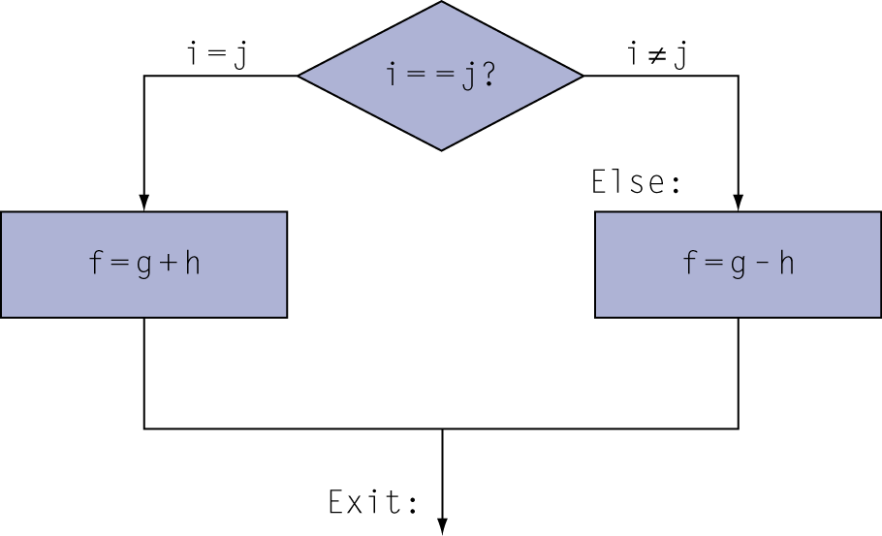
Compiling IF Statements
C code:
if (i==j) f = g+h; else f = g-h;
f, g, … in x19, x20, …
Compiled RISC-V code:
bne x22, x23, Else add x19, x20, x21 jal x0, Exit // unconditional branch Else: sub x19, x20, x21 Exit: …
Assembler calculates addresses

Slide 26
Compiling Loop Statements
C code:
for (i = 0; i < 10; i++
A[i] = A[i] + k;
i in x22, k in x24, address of A in x25
Compiled RISC-V code:
addi x22, x0, 0 // Initialize i addi x10, x0, 10 // Initialize loop termination LOOP: slli x11, x22, 2 // Multiply by 4 (byte addressing) ld x9, 0(x11) // Load A[i] add x9, x9, x24 // Add k sw x9, 0(x11) // Write A[i] addi x22, x22, 1 // Increment i blt x22, x10, LOOP // Check i

Slide 27
Which c-code is considered better firmware practice?
for (int j = 0; j < 1000; j++) {}
Or
for(int j = 1000; j != 0; j--){}
Does not need to tie up a register resource to compare a branch to, 1000. x0 register is a fixed constant that is always available.
An example of make the Common Case Fast

